Slide 1

Voice of Customer Dashboard: Starbucks
Cameron Webb

Slide 2
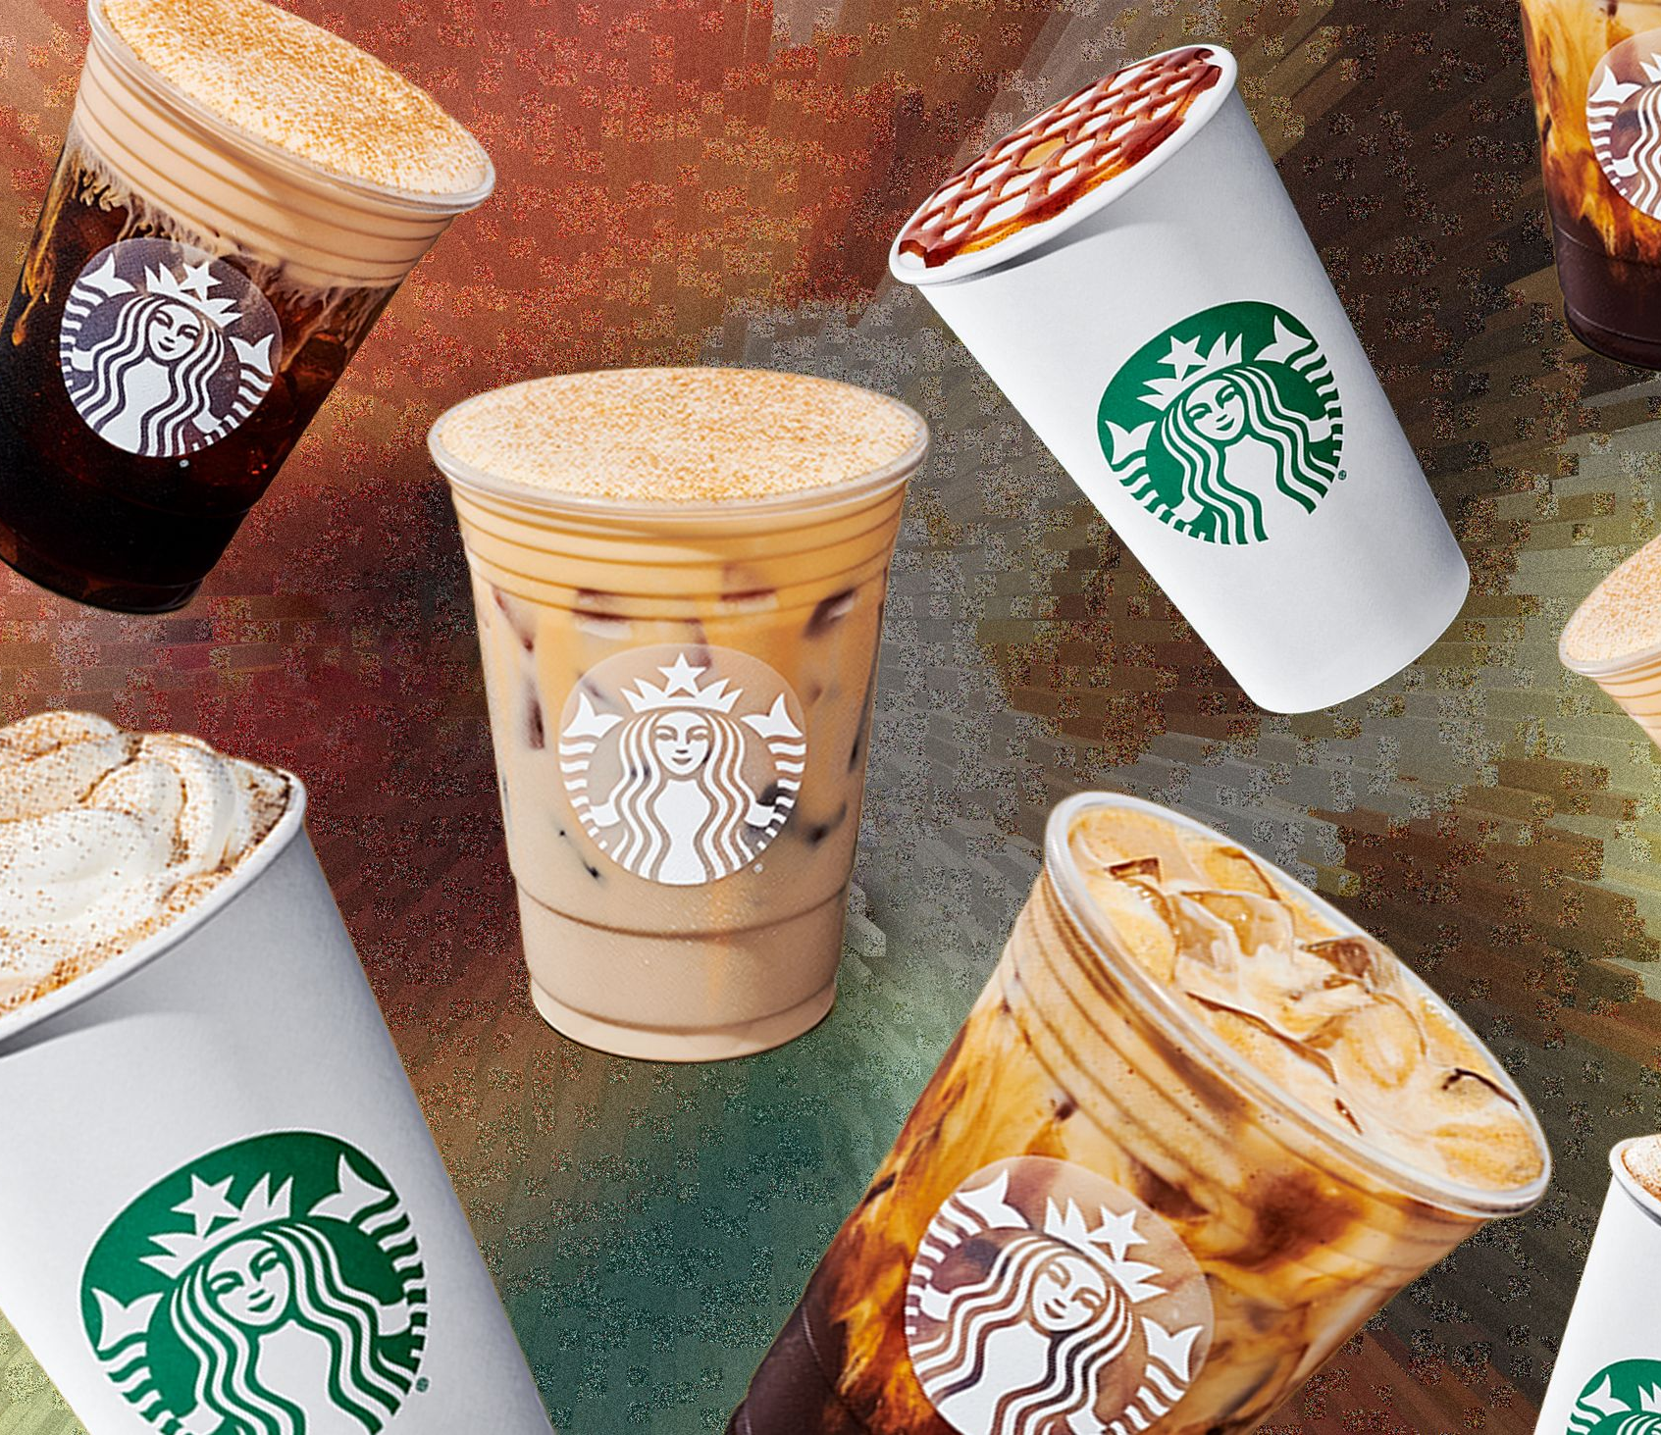
Brand Background
Founded March 30th 1971 at Seattle's Pike Place Market.
World's largest coffeehouse chain.
Approximately 16,834 stores in North America.
They stand by their mission statement of "one person, one cup and one neighborhood at a time."

Slide 3
Objective of the VOC
How users feel about Starbucks looking at Google Play, Google Maps, and Reddit reviews and ratings.
Wanting to understand customer needs better with the intent to improve positive experiences alongside reducing negative experiences
Distinguish between the two experiences of being instore and the digital experience
Obtaining strategic insights

Slide 4
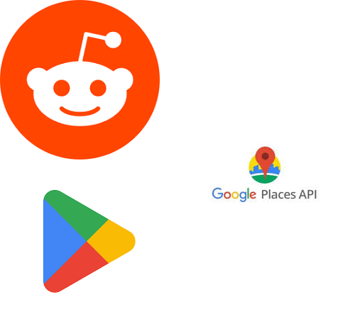
Data Sources Breakdown
The sources used were Reddit, Google Play, and Google Maps
Google Play Store – Starbucks App Reviews
Google Maps – In-store Reviews
Reddit – Community discussion & public sentiment

Slide 5
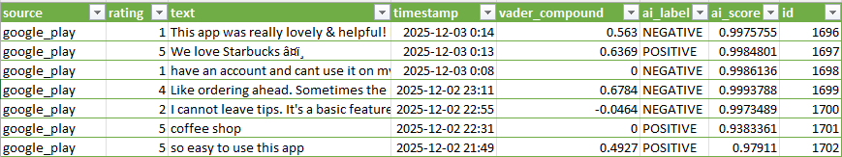
Google Play
Used Python library: google-play-scraper
Provided public access no API keys required
Collected, Star ratings, Review tex, Timestamp
Cleaned data: removed emojis, HTML entities, duplicate reviews
Exported to CSV for sentiment analysis

Slide 6
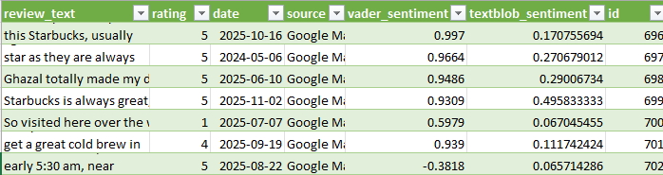
Google Places (Google Maps)
Used requests and BeautifulSoup to parse HTML from multiple Starbucks locations
Extracted publicly visible reviews from Google Maps business listings
Data fields collected:
Rating
Review text
Date
Location

Slide 7
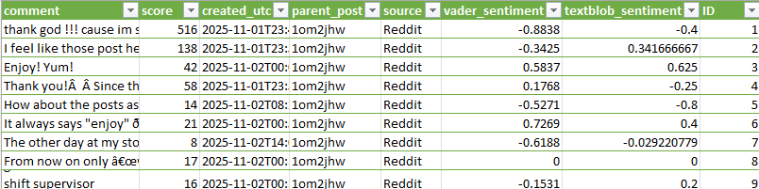
Reddit
Used PRAW, Reddit’s official API wrapper for Python
Required authentication: client ID, client secret, and a Reddit account
Focused on posts and comments from Starbucks-related subreddits
Data fields collected:
Comment text
Upvote score
Timestamp
Parent post reference

Slide 8
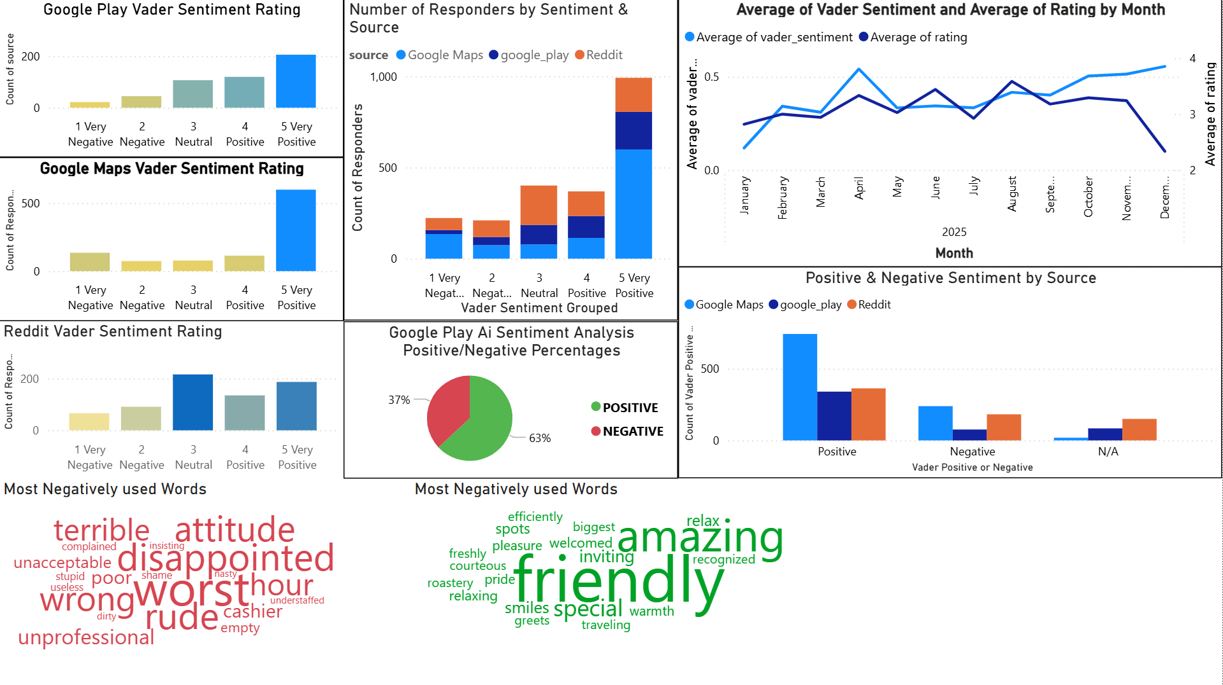

Slide 9
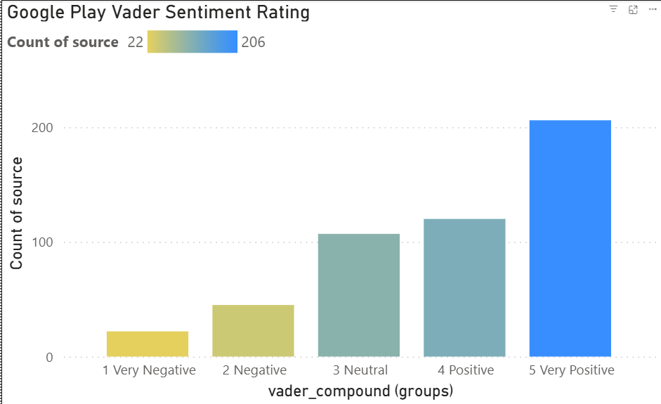
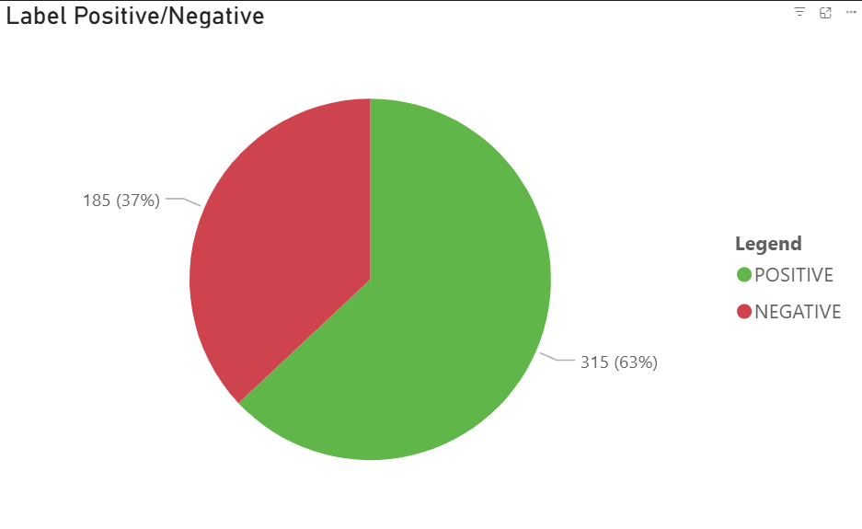
Dashboard Walkthrough (Google Play Store)
206 users have a rating of very positive.
Core sentiment is high with 63% positive feedback. The high negative (37%) is largely driven by the neutral responses.
Neutral responses don't preclude a negative experience but potentially point towards a lackluster one that may prevent 5-star ratings.

Slide 10
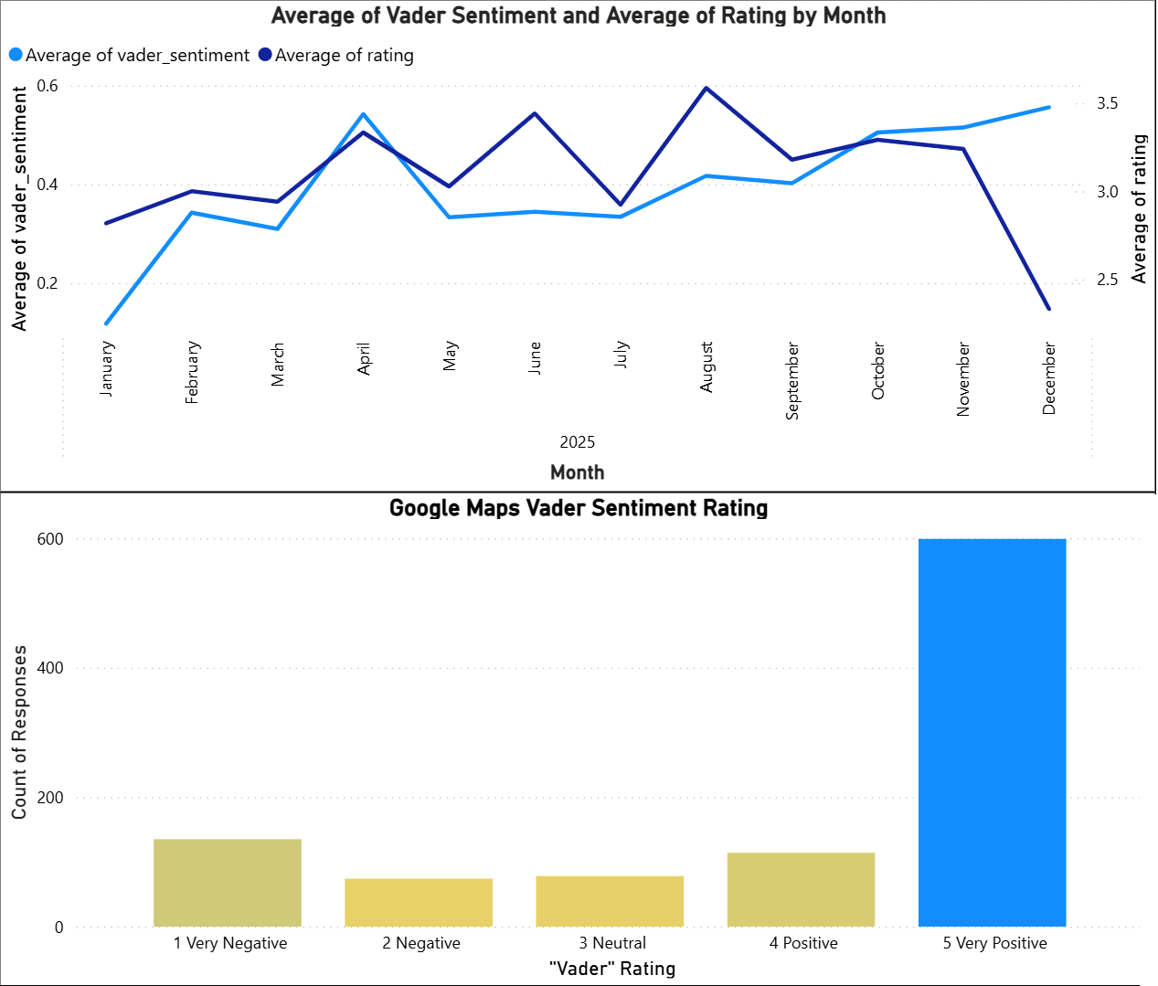
Dashboard Walkthrough (Google Maps)
Filtered to only year 2025
congruency or matching of trend line point to the fact that the sentiment and rating are moving in tandem, and making both metrics reliable
  in plainer terms, if the trend lines rise or fall at what looks like the same rate, it means that the ratings and sentiment values hold truth in relation to each other.
  if they're different, what customers rated the location may not be as bad or as good as they expressed in their comment/sentiment.
overall trend overtime shows fluctuations that seem to be somewhat cyclical
  a huge divergence happens in December, the
  holiday month, as ratings fall to its lowest
  average and sentiment rises to its highest average
binned the sentiment number values
the binning/grouping of values helps:
  to eliminate noise
  to point out a clear sentiment
Sentiment overall resoundingly very positive

Slide 11
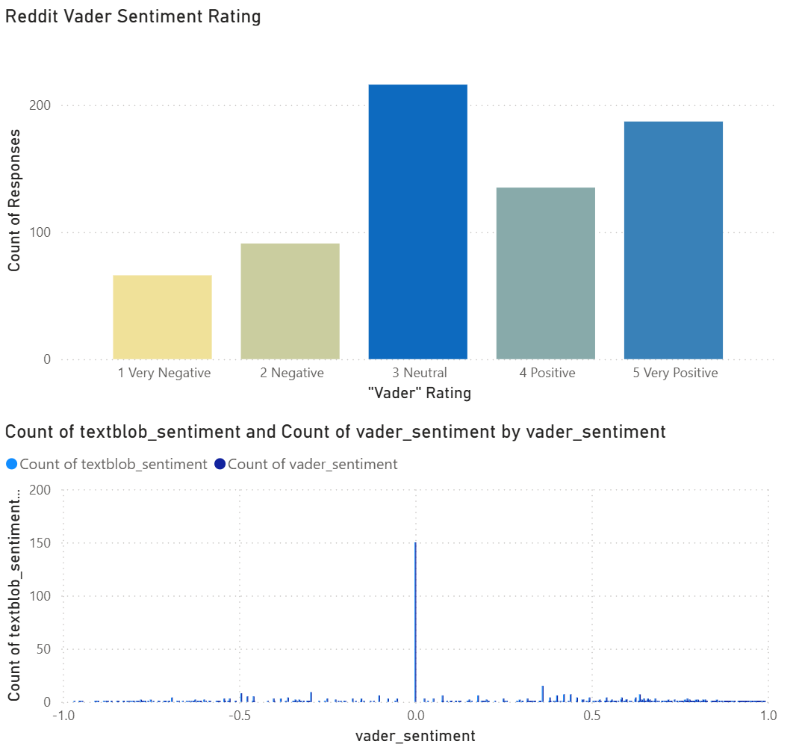
Dashboard Walkthrough (Reddit)
Sentiment analysis returned a lot of 0 values.
The analysis could not come up with a score for the response or deemed it unrelated
This skewed the data, inflating the number of responses in the neutral category

Slide 12
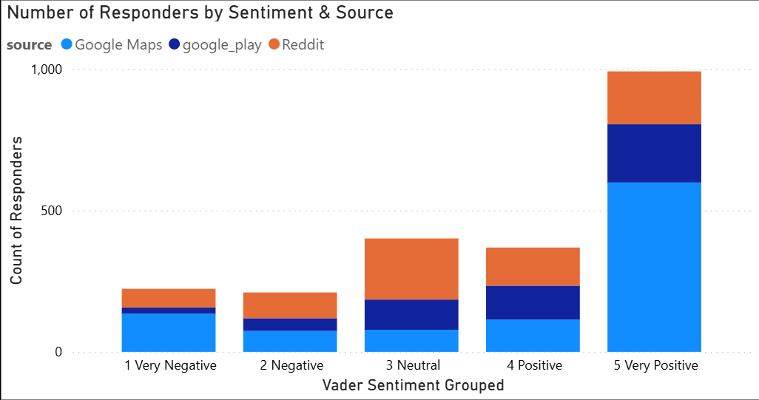
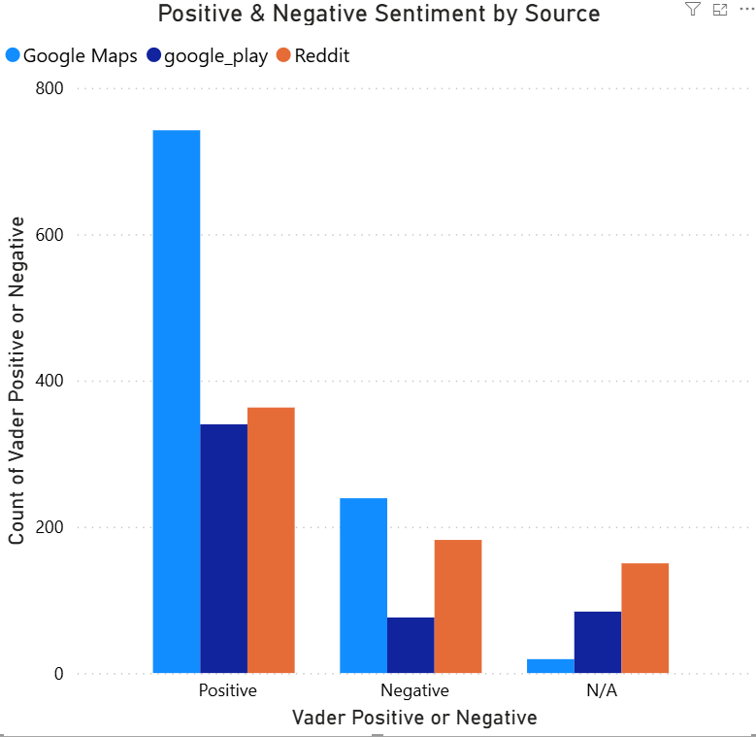
Combined Metrics
The graph shows the
continued sentiment of very positive reviews leading the
response count
Showcases how google maps
is contributing to most of the very positive sentiment and reddit contributing to most of the neutral sentiment
This graph shows google plays overwhelming contribution
to positive sentiment
It also shows google play’s
low level contribution to the negative sentiment in
comparison to other sources

Slide 13
Key Customer data-driven Insights
1. Store Experience
Clean, inviting, and convenient locations praised
Limited seating & parking frustrations
2. Staff & Service
Friendly, efficient, personalized service = high satisfaction
Rude or inattentive staff = negative experiences
3. Product Quality
Coffee & specialty drinks highly rated
Order mistakes or mismatched expectations frustrate customers

Slide 14
Key Customer data-driven Insights
Digital Experience (App)Mobile ordering & rewards popular
App bugs, inability to tip, or update issues = major complaints
5. Social / Cultural Experience
Cup messages & small personal touches appreciated
Repetitive trends or overly strict enforcement annoy some customers
6. Overall Insight
Loyalty driven by staff, quality, & convenience
Operational and digital friction = key improvement areas

Slide 15
Recommended Actions
1. Attack Digital Instability First (Google Play)
Insight: Technical failures—like the inability to leave tips and app update bugs—are the core driver of our low app ratings.
Action: Dedicate immediate engineering resources to fix critical bugs and enhance overall app stability.
Goal: Quickly elevate the average Google Play rating and improve user experience.
2. Elevate In-Store Operational Excellence (Google Maps)
Insight: Many negative reviews mention poor staff attitude, order inaccuracy, and managerial inconsistencies.
Action: Invest in new training modules for store managers to boost conflict resolution, ensure consistent order preparation, and reinforce personalized service.
Goal: Reduce the volume of negative transactional feedback and improve in-store service perception.
3. Take Control of Brand Policy Discourse (Reddit)
Insight: High-visibility, negative community sentiment targets corporate policies, employee wages, and major brand decisions.
Action: Create a dedicated Community/Policy Liaison role to actively monitor high-impact discussions and inform corporate communications strategy.
Goal: Achieve a long-term, positive shift in brand perception and corporate dialogue within our most engaged online communities.

Slide 16

Questions??

